Slide 1
2022

Slide 2
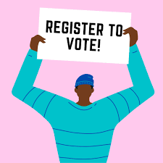
Why Register to Vote?

Slide 3
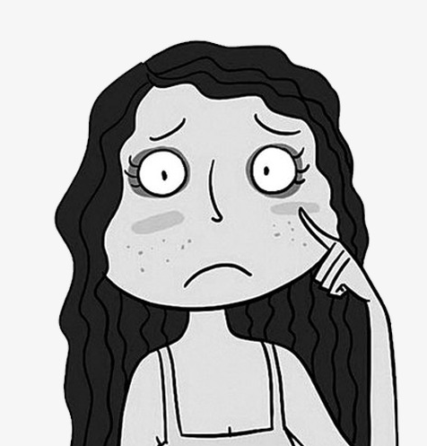
Maybe you’ve heard somebody say something like...
“I don’t vote because my one vote won’t make a difference.”
“I don’t vote because I don’t love any of the candidates. They’re really all the same.”
“I don’t vote because I don’t know enough about the candidates or the issues.”
“I don’t vote because it’s just one more thing to do and I’m busy.”

Slide 4
Maybe you agree with one of these statements?
Either way, we hope to convince you that your vote does make a difference, show you how you can be an informed voter, and make it easy for you to register to vote.

Slide 5
INSPIRATION YOU CAN SHARE...

Slide 6
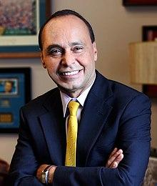
“Too many people fought too hard to make sure all citizens of all colors, races, ethnicities, genders, and abilities can vote to think that not voting somehow sends a message.”
— Luis Gutierrez, former U.S. Representative (Illinois 4th congressional district)

Slide 7
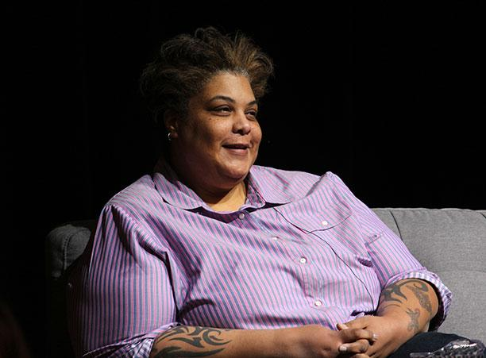
“Voting isn’t dating. We are not promised perfect candidates. Voting requires pragmatism and critical thinking and empathy and now, more than ever, intelligent compromise.”
— Roxane Gay, writer and social commentator

Slide 8
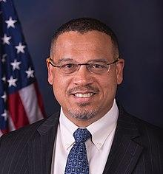
“Not voting is not a protest. It is a surrender.”
— Keith Ellison, Attorney General of Minnesota

Slide 9
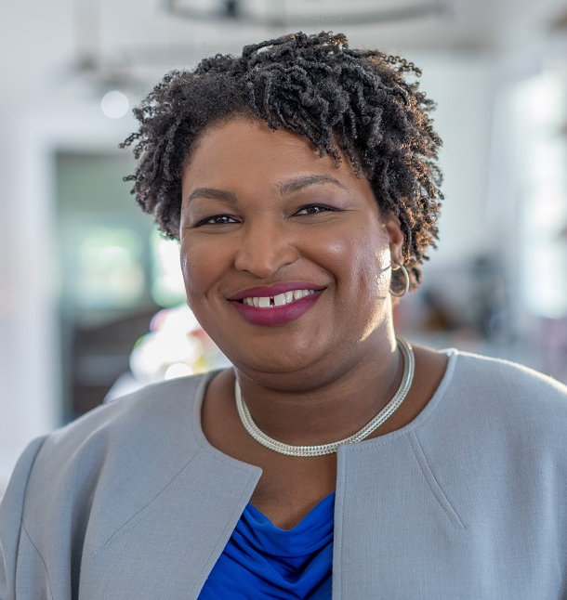
“Protest to demand attention to the wrenching pain of systemic injustice. Vote because we deserve leaders who see us, who hear us and who are willing to act on our demands.
Voting will not save us from harm, but silence will surely damn us all.”
— Stacey Abrams, founder of Fair Fight Action

Slide 10
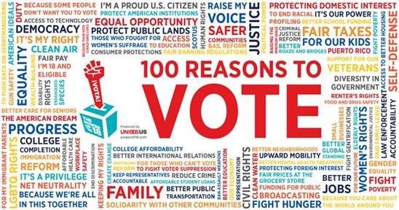
Why is voting so important that people have died defending their right to vote?
Because your vote is your voice on issues that matter to you:

Slide 11
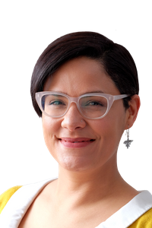
Let’s look at some of the reasons people choose not to vote.
What some people say “I don’t vote because my one vote won’t make a difference.”
But many elections are surprisingly close!
Most famously, in 2000, the Presidency was decided by 537 votes in Florida, handing the victory to Republican George W. Bush.
Locally, in 2019, Rossana Rodríguez Sanchez— who worked in the Columbia College Chicago Career Center— won her Chicago aldermanic seat by just 68 votes.

Slide 12
And...
What some people say: “I don’t vote because I don’t love any of the candidates. They’re really all the same.”
But candidates aren’t all the same: They differ on issues that matter, like:
health care climate change LGBTQ+ rights gun violence
policing incarceration immigration student financial aid
Aborion taxes the environment affording housing
….and voting rights, too!

Slide 13
And...
What some people say “I don’t vote because I don’t know enough about the issues.”
But it’s easier than ever to get information on candidates and issues: We’ll give you some resources so that you can be confident about voting informed.

Slide 14
And even if you aren’t eligible to vote, you can encourage people who are...
Eligibility:
U.S. citizen
State residency requirements
18 years old on or before election day
Registered to vote by your state’s deadline
In some states, people with felony convictions lose their right to vote, temporarily or permanently.

Slide 15
The youth vote is powerful. And in danger:
The Student Vote Is Surging. So Are Efforts to Suppress It. —The New York Times, Oct. 24, 2019
Young People Aren’t Apathetic. They’re Facing Major Voting Obstacles —VICE, March 13, 2020
Fourteen States Have Enacted 22 New Laws Making it Harder to Vote —CNN, May 28, 2021
Texas Law Poses Threat to Student Voting —Inside Higher Ed, Sept. 25, 2021
But the Higher Education Act requires that voter registration be offered in college. And though you can’t vote until you’re 18, many states permit you to register earlier.

Slide 16
And it’s not just the youth vote.
Since the 2020 elections, laws in many states have been designed to make it harder to vote, such as…
Strict voter ID laws
Purges of voting rolls
Elimination of ballot drop boxes
Limiting early voting
...and even prohibiting people from giving water to voters stuck in long lines at polling places!

Slide 17
This is happening because your vote can make a real difference.
So use the force!

Slide 18
Your vote is especially powerful in midterm elections because fewer people vote in them.
Members of Congress influence everything from pollution to criminal justice reform to funding for the military, the arts and social programs. They also approve presidential nominees – including judges.
State and local elected officials make decisions that affect you every day:
Legislation on reproductive rights, LGBTQ+ rights and even voting rights
funding for schools, libraries, parks and public transit
oversight of police departments, courts and public works

Slide 19
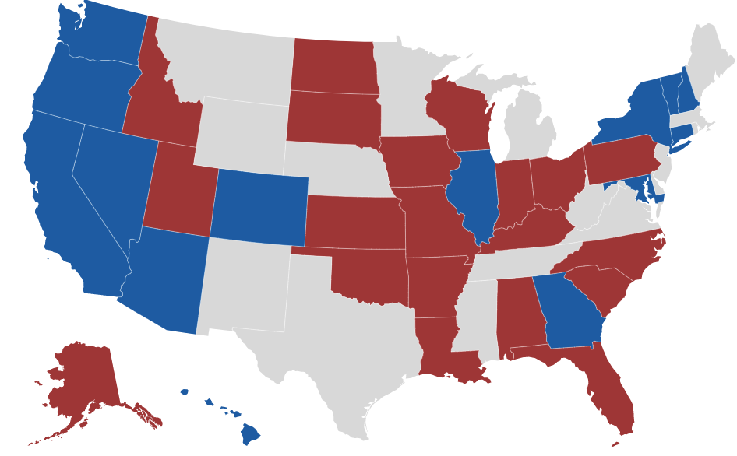
And in 2022, 34 of the 100 Senate seats are up for election.
14 are held by Democrats and 20 by
Republicans. Right now, the Senate
is split 50-50, so the 2022 election
will determine whether progressive
or conservative legislation gets
passed or is blocked.
This is a very big deal.
And all members of the House of Representatives are up for election every two years!

Slide 20
College students have a
superpower!
You can choose to vote as a resident here on campus or as a resident where your parents live.
If you feel more connected to issues or candidates back home, you can register at your parents’ address and vote there in person or by mail.

Slide 21
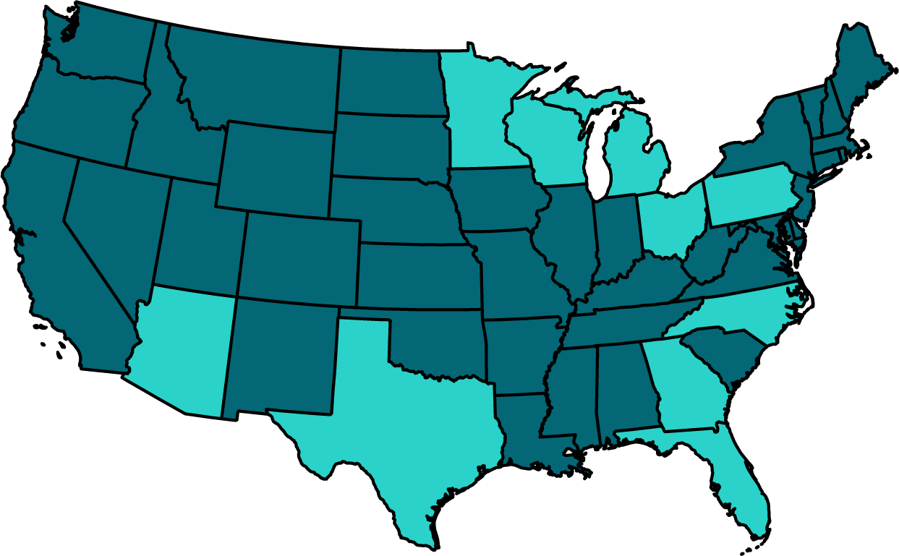
During a presidential election year, if you are from a swing state, voting there has more influence.
MI WI OH MN NC PA TX AZ GA FL
* What’s a “swing state?” One where the outcome could go either way, based on just a few votes.

Slide 22
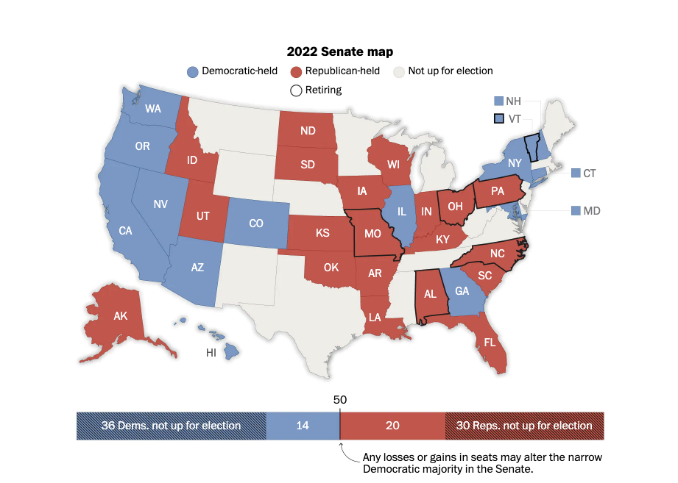
The midterm elections determine the balance of power in the Senate and House of Reps.
Source: Washington Post

Slide 23
And local elections are happening
all the time!
In November 2022, there will be 36 governors, 30 lieutenant governors, 30 attorneys general, and 27 secretaries of state up for election.
There will also be lots of “down ballot” elections.
Find out about your local elections at Ballotpedia.org

Slide 24
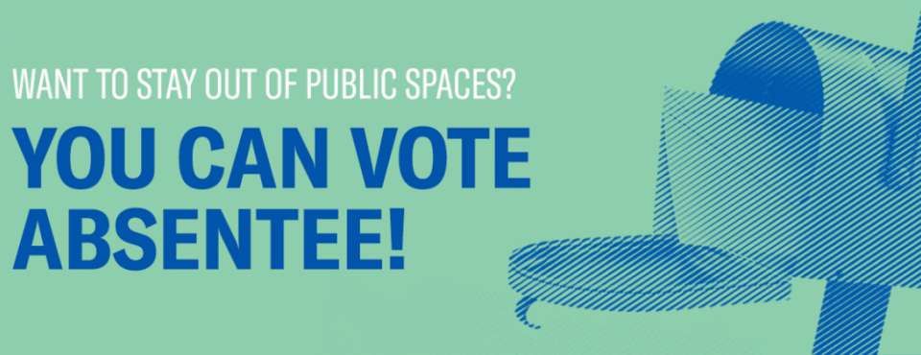
So think about where you want to vote
For now, you just need to register.
Next year, if you want to vote-by-mail at either location, we’ll help you do that.
FOR NOW, CHOOSE:
Option 1: Here on campus
Option 2: Back home
AKA Vote-by-Mail!

Slide 25
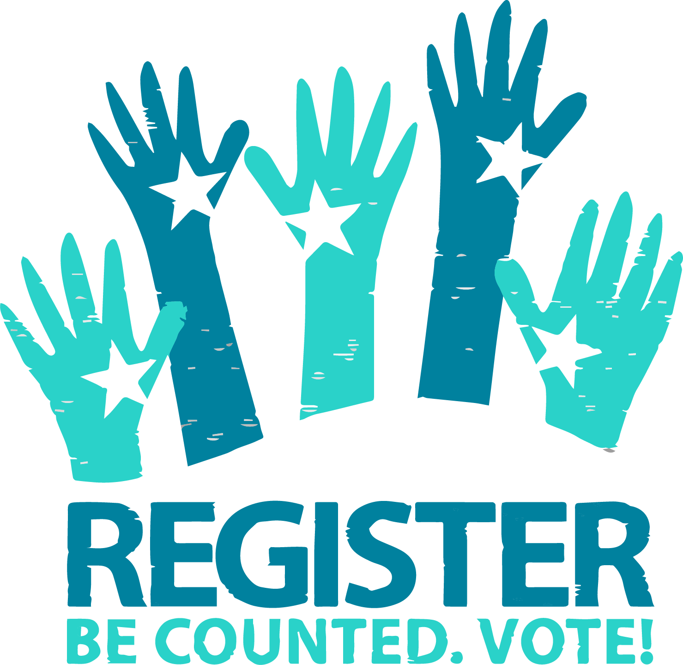
Convinced?
It really is important to register to vote, and we are here to make it easy for you.
And if you aren’t eligible to vote, you can help encourage people who are.

Slide 26
If you are already registered to vote and you do not want to change your registration location, or if you are not eligible to vote or don’t want to, you’re done!
If you are not registered to vote or you are already registered to vote and you do want to change your registration, move to the front of the room.

Slide 27
Let’s do it!
We will distribute a registration form.
Please follow along with us as we fill it out together--in ink and in your neatest handwriting.
Then we’ll photocopy your ID, put everything in an envelope and mail it for you*
*Unless you are from Texas or New Mexico, in which case you’ll stuff the envelope and mail it yourself!
Notes:
.

Slide 28
Get your Driver’s license or state ID out
If you are from one of these states, you’ll need your social security number instead:
Kentucky
New Mexico
Tennessee
Virginia
Missouri wants both your driver’s license and SSN, if you have both
These states require DL: Maryland, Connecticut and Iowa
If you are from Texas, New Mexico or Wyoming, come see us.
This is what you will need to put on line 6.

Slide 29
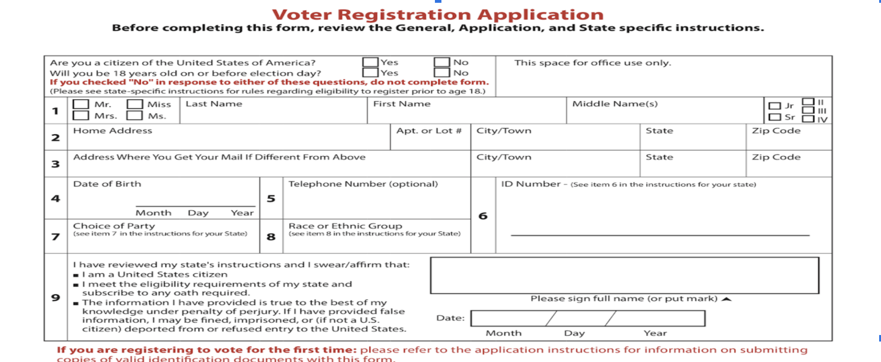
LEAVE THIS LINE BLANK!!

Slide 30
Addresses for residence halls
IF YOU LIVE IN: THE ADDRESS IS:
30 East 30 E. Balbo Dr., Chicago IL 60605
The Dwight 642 S. Clark St., Chicago IL 60605
The University Center 525 S. State St., Chicago IL 60605
The Arc 37 W. Van Buren St., Chicago IL 60605
Don’t forget to include your unit number!

Slide 31
What will happen next?
Meet us outside this room so we can photocopy your ID and take care of the paperwork.
We’ll give you a “what’s next” document and a Columbia Votes bracelet!
After you register to vote, you should receive a voter card in the mail. (This card shows your residence address and voting location; it is not required for voting.)
You can go to BallotReady.org or vote411.org to find out about everyone who will be on your ballot and make your choices.
If you want to vote by mail, we can help you request that, too.
You’re all set to vote in the midterm election, either by mail or in person!

Slide 32
If you need any help, we’re here!
If you have any problems completing the process, you can get one-on-one help from a voter registration genius!
Send an email to vote@colum.edu and we’ll set up a time to meet with you at the Student Center, on the phone or by video conference.
And follow us on Instagram!
Columbia_Votes

Slide 33
That’s it!

